Slide 1
Orbit Perturbations
Dr. R. Pandiyan

Slide 2
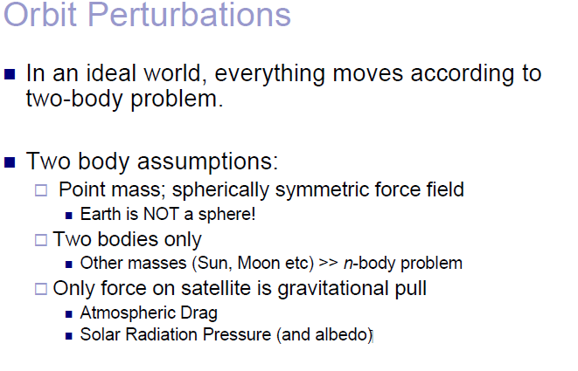

Slide 3
Orbital Perturbations
So far we studied orbits only with central gravity forces
Several factors cause perturbations to a spacecraft’s orbit and / or attitude
Drag
Earth’s oblateness
Actuators
3rd bodies
Gravity gradient
Magnetic fields
Solar pressure

Slide 4
Orbit Classifications
Orbits are classified as
based on their functions
based on their altitude heights
based on their inclination
based on the way they move about planet
some special orbits based on perturbation theory
coverage pattern – constellations etc

Slide 5
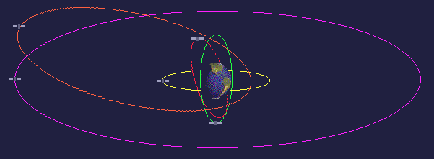
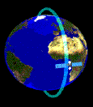
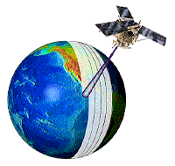
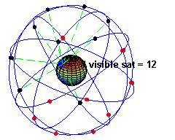
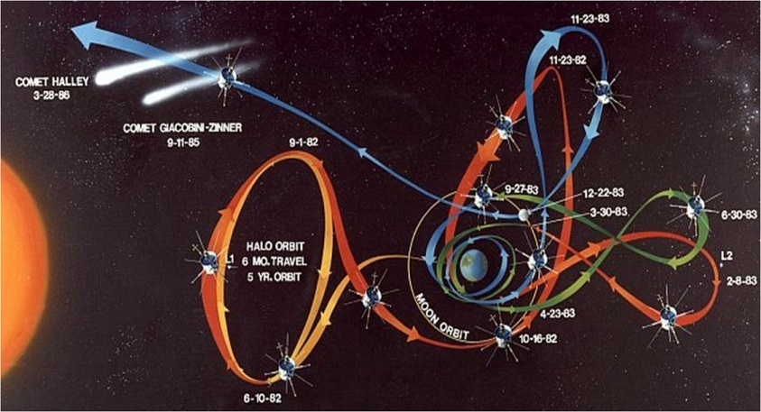
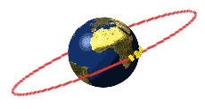
Different Types Of Orbits & Trajectories for Satellites In Space
Low Earth Orbits
(250km To 1000 km Ht.)
Earth Imaging
Reconnaissance
Space Shuttle
Astronomy
Medium Altitude Orbits
(1000 Km To 20,000 km Ht.)
Earth Imaging
Communications
Navigation
Astronomy
Experiments
Hyperbolic Orbits
(With V > Escape Velocity)
Inter Planetary Travel/Exploration
High Altitude Orbit
(20,000 km And Above)
Communication(GSAT/INSAT)
Astronomy
(Especially Sun Related Studies)
Navigation
Halo Orbits

Slide 6
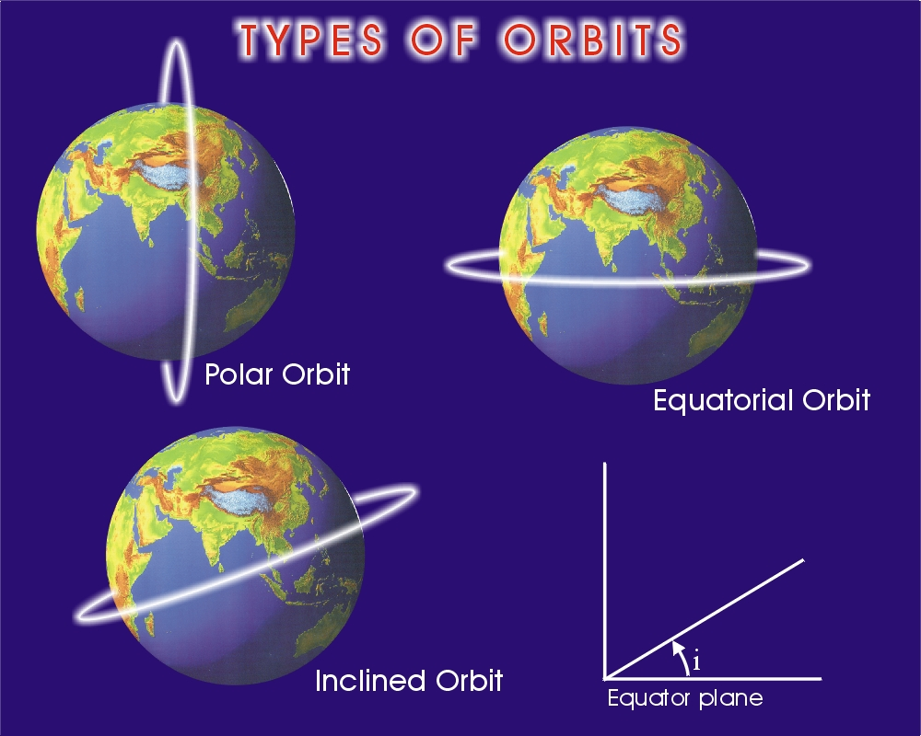
N
Equatorial plane

Slide 7
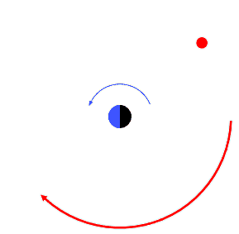
PROGRADE / RETROGRADE

Slide 8
Artificial Satellites - Usefulness
Communications ( TV, Telephone etc)
Earth Imaging (earth resources, cartography etc)
Meteorologly (weather prediction)
Astronomy ( to understand the space, evolution etc)
Global Positioning System Satellites –
(rescue operations, distress situations)

Slide 9
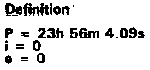
Arthur Clarke’s Scheme
Stationary orbit
Geo-synchronous Orbit
Clarke Orbit
36,000 km
Visibility zones of Satellites
Satellite revolves at same angular speed as the earth
Illustrating global communication with the use of three stationary satellites
GEO-STATIONARY ORBIT
FOR COMMUNICATION

Slide 10
GSO : Geo-stationary orbit
The orbit with the same earth rotation rate (Orbital period of 23 Hrs 56 mins 4.1secs) is called an earth
synchronous orbit or geosynchronous orbit.
The geosynchronous orbit with an inclination of zero deg (i = 0 deg) is called a geostationary orbit because the satellite looks stationary over the equator from a ground surface view.
A Geostationary satellite is useful for covering wide areas. Many meteorological satellites and communication satellites are geosynchronous types.

Slide 11
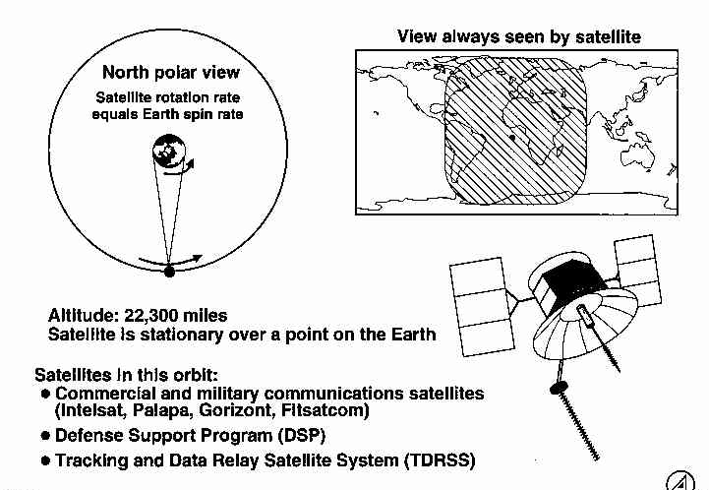
Coverage of Geo-Synchronous Orbits
Source: Satellite Design and Space Applications, David J. Kim,
Aerospace Corporation, 18 November 1992

Slide 12
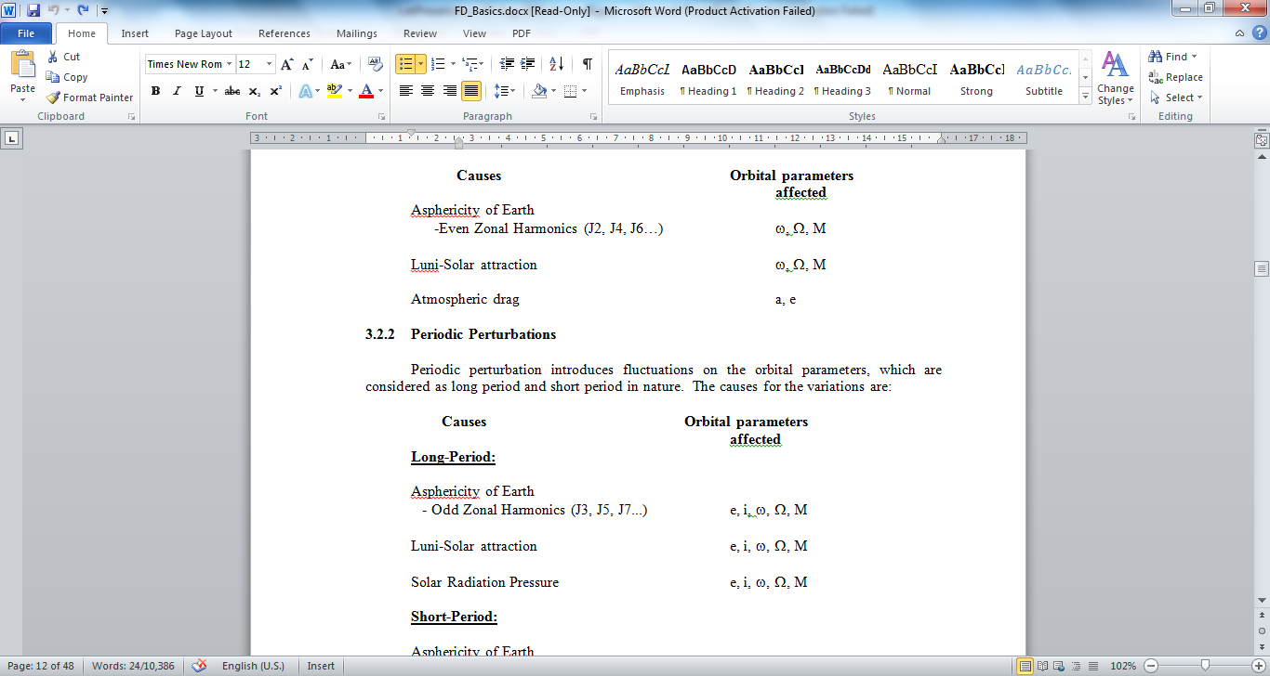
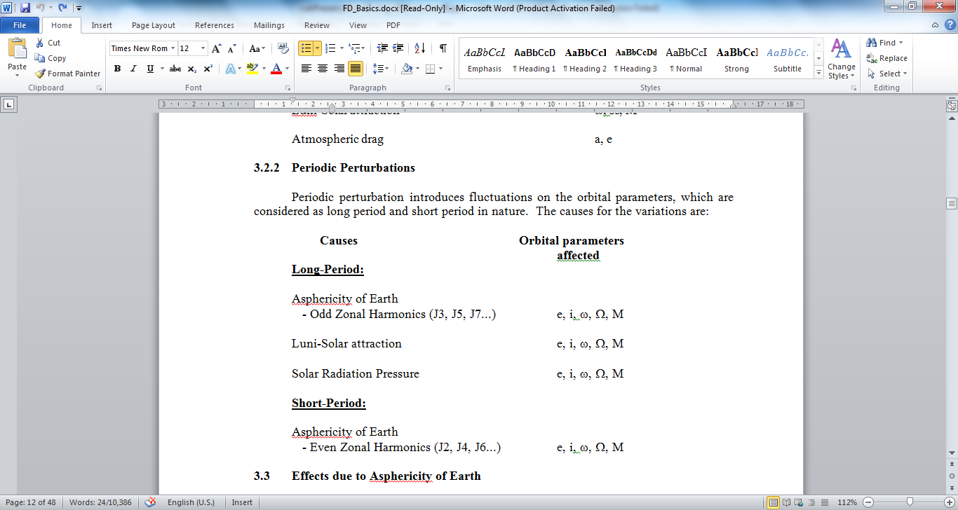
Perturbed Motion
Perturbations
Secular
Long Periodic
Short Periodic
Periodic

Slide 13
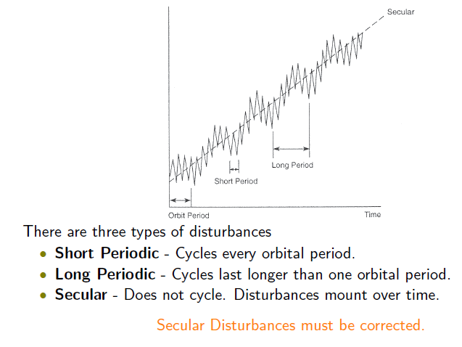
Effects of Perturbations

Slide 14
ORBIT PERTURBATIONS the 4 important sources of perturbations
Asphericity of Earth
Luni-Solar force (Third Body)
Aerodynamic Drag
Solar Radiation Pressure

Slide 15
Varying Disturbance Torques
NOTE: The magnitudes of the torques is
dependent on the spacecraft design.
Drag
Torque (au)
Gravity
Solar
Press.
Magnetic
LEO
GEO
Orbital Altitude (au)

Slide 16
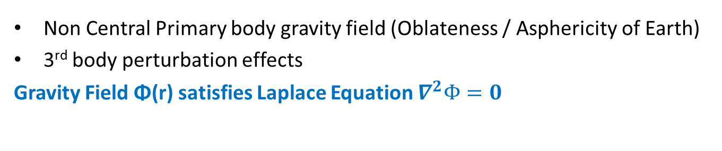
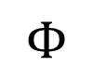
Perturbations derivable from Potential Functions
Non Central Primary body gravity field (Oblateness/ Asphericity of Earth)
3rd body perturbation effects
Gravity Field Φ(r) satisfies Laplace Equation $∇^{2}Φ=0$
$$Φ$$
Irregularities in the Earth’s Gravitational Field modeled by a complex Mathematical Model referred to as Gravitational Potential Theory

Slide 17
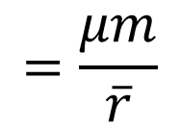
Gravitational Potential: Spherical Earth
Energy Stored when an object of mass
M, is pulled to a near earth distance r
from infinity
Φ
$$=\frac{μm}{\overline{r}}$$

Slide 18
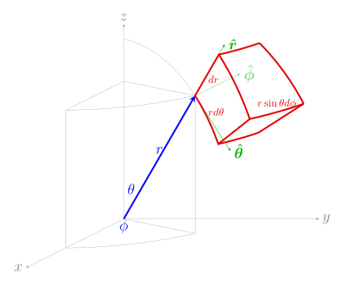
Gradient Operator in Spherical Coordinates

Slide 19
Spherical Earth Produces No Orbital Torque
• Gravity produces no
Orbital torque for spherical
Earth
• Gravitational Force acts
Through center of earth
• Satisfies Laplace’s equation
= 0
= 0

Slide 20
LAPLACE Operator in Spherical Coordinates

Slide 21
Gravitational Potential: Spherical Earth (cont’d)
• Satisfies Laplace’s equation
OK!

Slide 22
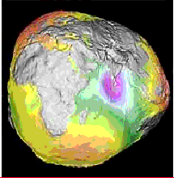
Shape of the Earth as computed
Earth’s Asphericity: Computed Earth Potential model by 19 March 2002
• In actuality, Earth is an Ellipsoid
With lots of warts on the surface!
Professor B. D. Tapley, University of Colorado, Boulder, USA
Works continuously on this and releases Earth Gravity models
The Earth is Not a Perfect Sphere

Slide 23
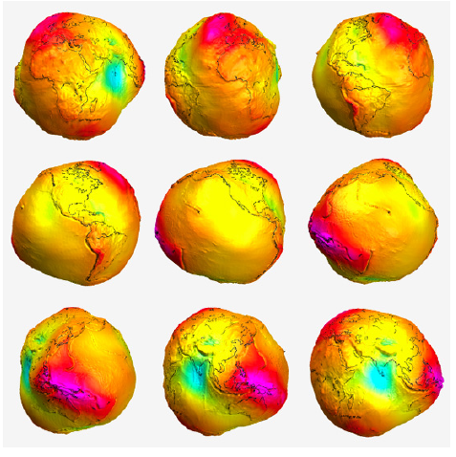
Various snap shots of earth
Gravity anomalies measured at the surface is used to define the shape of geoid using Stoke’s Theorem – 1850
Satellite Data measures the gravity anomalies all over the geoid including oceans
Sputnik launch – showed that the latitudinal potential change is larger than measured at surface

Slide 24
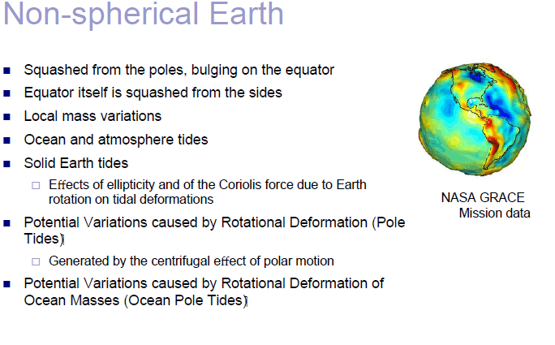

Slide 25
Mean Equatorial “Bulge”

Slide 26
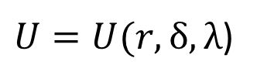
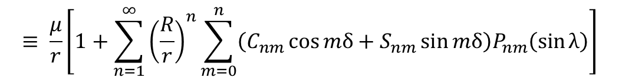
Gravitational Potential: Non-Spherical Earth
• For nearly spherical body,
gravity potential is
For a more realistic Earth model
… warts and all … we have to expand
the potential function to include
additional gravitational terms … the
“Spherical harmonics”
$U=U(r,δ, λ$)
In Legendre polynomials we can expand U in r, δ, λ (colatitude φ = 90 – λ) as
Ouch!
This hurts
$$≡ \frac{μ}{r}\left[1+\sum_{n=1}^{∞}{{\left(\frac{R}{r}\right)}^{n}\sum_{m=0}^{n}{\left(C_{nm}\cos{mδ+S_{nm}\sin{mδ}}\right)P_{nm}\left(\sin{λ}\right)}}\right]$$

Slide 27
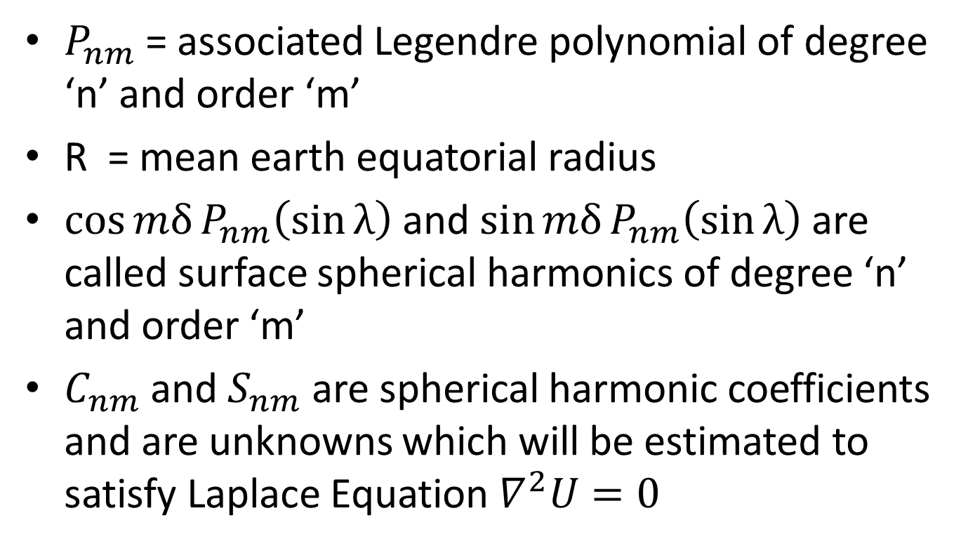
Spherical Harmonics
$P_{nm}$ = associated Legendre polynomial of degree ‘n’ and order ‘m’
R = mean earth equatorial radius
$\cos{mδ}P_{nm}\left(\sin{λ}\right)$ and $\sin{mδ}P_{nm}\left(\sin{λ}\right)$ are called surface spherical harmonics of degree ‘n’ and order ‘m’
$C_{nm}$ and${ S}_{nm}$are spherical harmonic coefficients and are unknowns which will be estimated to satisfy Laplace Equation $∇^{2}U=0$

Slide 28
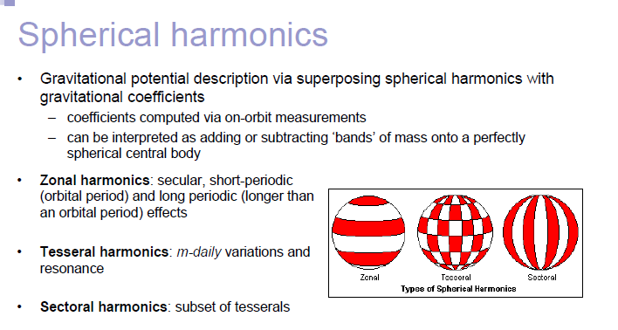
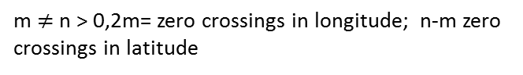
m = 0, n= zero crossings in latitude; $S_{nm}=S_{n0}=0$
m $≠$ n > 0,2m= zero crossings in longitude; n-m zero crossings in latitude
m = n,2m= zero crossings in longitude; no zero crossings in latitude

Slide 29
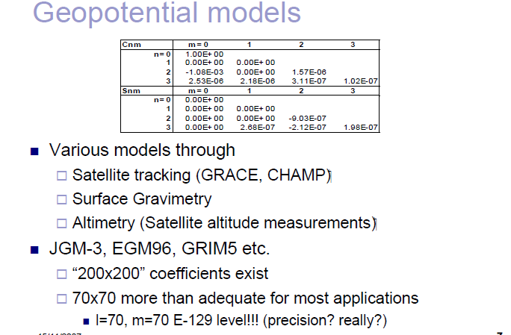

Slide 30
Gravity Models
Earth Gravity Model – 1996 – EGM-96 (360,360) complete degree and order model is available
Earth Gravity Model – 2008 – EGM2008 - contains spherical harmonic degree and order 2159
GRACE Gravity Model -03 - GGM03 contains spherical harmonic degree and order 180 (360) purely based on 4 years observation of GRACE – developed by B. D. Tapley
Joint Gravity Model-3 – JGM-3 – uses precise laser altimeter data as well – credit to B. D. Tapley

Slide 31
Further Simplifications
• Fortunately, for a planet that is
symmetrical about the Z (polar) axis,
and has North/South symmetry, the
form of the potential function reduces
considerably
• The so-called gravitational Multi-pole
expansion
Here φ = is co-latitude (that is 90-λ) Remember !!!

Slide 32
Gravitational Potential: Non-Spherical Earth (cont’d)
• P_{2n}(cos(φ) ) are the Legendre polynomials, and
•J_{2n} are the gravitational moments “J-numbers”
• R_{e} Equatorial Planetary radius
• φ is the co-latitude (measured from polar axis)

Slide 33
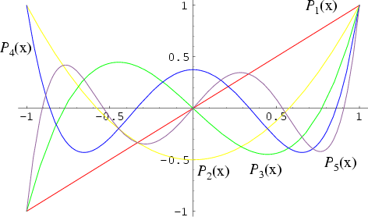
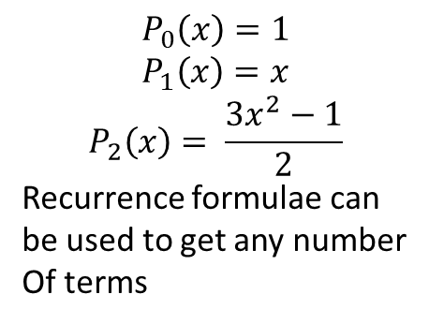
Gravitational Potential: Non-Spherical Earth (cont’d)
$$P_{0}\left(x\right)=1$$
$$P_{1}\left(x\right)=x$$
$$P_{2}\left(x\right)= \frac{3x^{2}−1}{2}$$
Recurrence formulae can
be used to get anynumber
Of terms
• Legendre polynomials

Slide 34
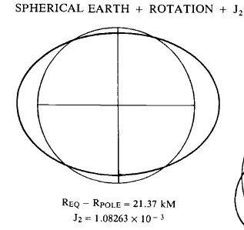
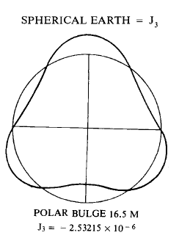

Shape of Earth due to $$J_{2} and J_{3}$$

Slide 35
Gravitational Potential Theory, J₂ Model (cont’d)
• J1 --> Gravitational Potential of Spherical earth
• J2 --> Accounts for Equatorial Bulge
• So-named J2 Effect
J2 -- torques the orbit

Slide 36
Gravitational Potential: Non-Spherical Earth (cont’d)
• If the harmonics are truncated after second order term in
the expansion, the resulting “J₂” model is
•J₂ is the second order gravitational moment”
• R_{e} Equatorial Planetary radius
• φ is the co-latitude (measured from polar axis)

Slide 37
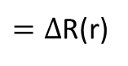
Gravitational Potential Theory J₂ Model
$=∆$R(r)
Note: $∆$R(r) is function of ‘r’ and co- latitude ‘φ’ and thereby function of a,e,i only [Since $\sin{φ=\sin{i}\sin\left(ω+θ\right)}$by spherical trigonometry.

Slide 38
Gravitational Potential Theory J₂ Model (cont’d)
From harmonic analysis
ρ(r,μ) -> planetary density function
• J2 Gravitational Moment is approximated by:

Slide 39
Gravitational Potential Theory J₂ Model (cont’d)
What is J₂ for earth based on this model
=
=
0.00108144
However, Please note that it can be proved that Gravitational acceleration vector does not pass through center of earth; so it produces torques on the orbit plane

Slide 40
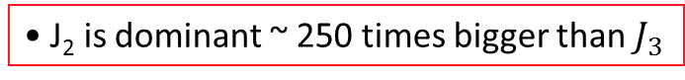
Gravitational Potential: Non-Spherical Earth (cont’d)
• J₂ is dominant ~ 250 times bigger than $J_{3}$

Slide 41
Force of gravity, J₂ model
• Prove that “J₂” gravity no longer acts thru earth center

Slide 42
Force of gravity, J₂ model (cont’d)

Slide 43
Force of gravity, J₂ model (cont’d)

Slide 44
Force of gravity, J₂ model (cont’d)
Gravitational acceleration vector does not
pass through center of earth

Slide 45
Force of gravity, J₂ model (cont’d)
• At Earth surface
Radial Acceleration of gravity

Slide 46
Force of gravity, J₂ model (cont’d)
• At Earth surface Radial Acceleration of gravity, Normalized to 1g
g/g₀
North pole
λ
South pole
equator

Slide 47
Force of gravity, J₂ model (cont’d)
• At Earth surface
North/South (longitudinal) Acceleration of Gravity

Slide 48
Force of gravity, J₂ model (cont’d)
• At Earth surface North/South (longitudinal)Acceleration
of gravity Normalized to 1g
g/g₀
North pole
λ
South pole
equator

Slide 49
How Does J₂ Torque the Orbit? (cont’d)
• Spherical Earth …
Gravitational force acts
On a straight line between CG
Of satellite and the center of
the earth
• No moment arm to act on
.. Thus no torque

Slide 50
How Does J₂ Torque the Orbit? (cont’d)
• Oblate (J₂) Earth …
• Spacecraft is closer to
the centroid of one
hemisphere than the
centroid of the
other hemisphere
Distance from hemisphere centroid

Slide 51
How Does J₂ Torque the Orbit? (cont’d)
• Oblate (J₂) Earth …
• Gravitational force no longer
acts through center of the earth
Gravitational Force Vector

Slide 52
J₂ Gravity Model orbital plane effects (cont’d)
• Effect of F_{λ}
• Effect of F_{κ}

Slide 53
How Does J₂ Torque the Orbit? (cont’d)
• Oblate (J₂) Earth …
• Net torque on orbit
Due to vector results
in precession of the
line-of-nodes

Slide 54
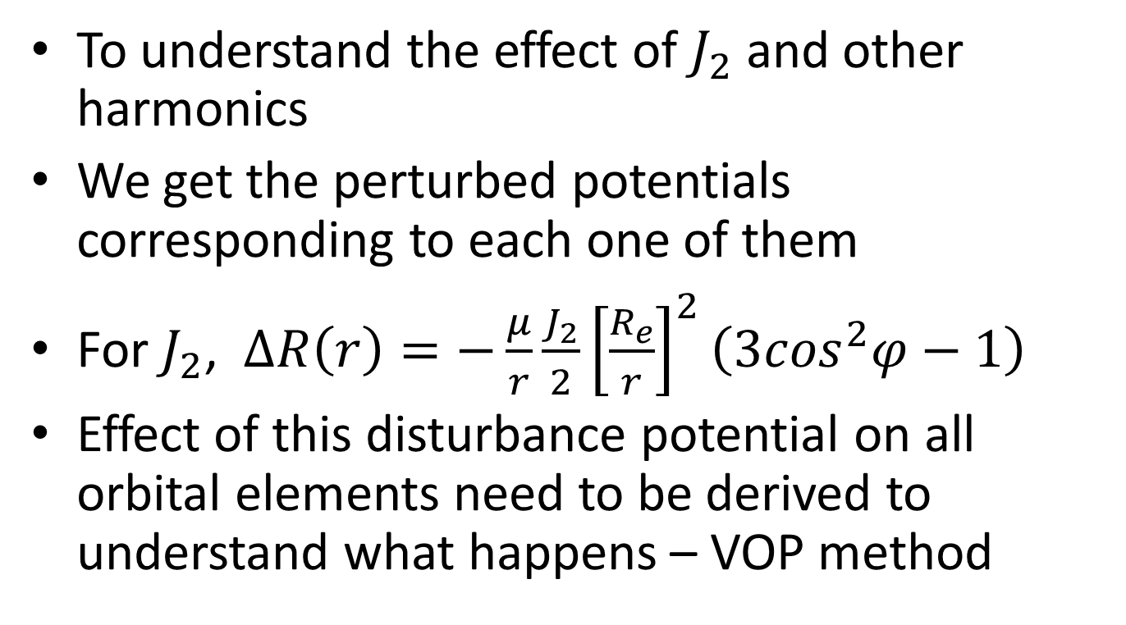
Concept of Variation of Parameters
To understand the effect of $J_{2}$ and other harmonics
We get the perturbed potentials corresponding to each one of them
For $J_{2}$, $∆R\left(r\right)=−\frac{μ}{r}\frac{J_{2}}{2}{\left[\frac{R_{e}}{r}\right]}^{2}\left(3\cos^{2}φ−1\right)$
Effect of this disturbance potential on all orbital elements need to be derived to understand what happens – VOP method

Slide 55
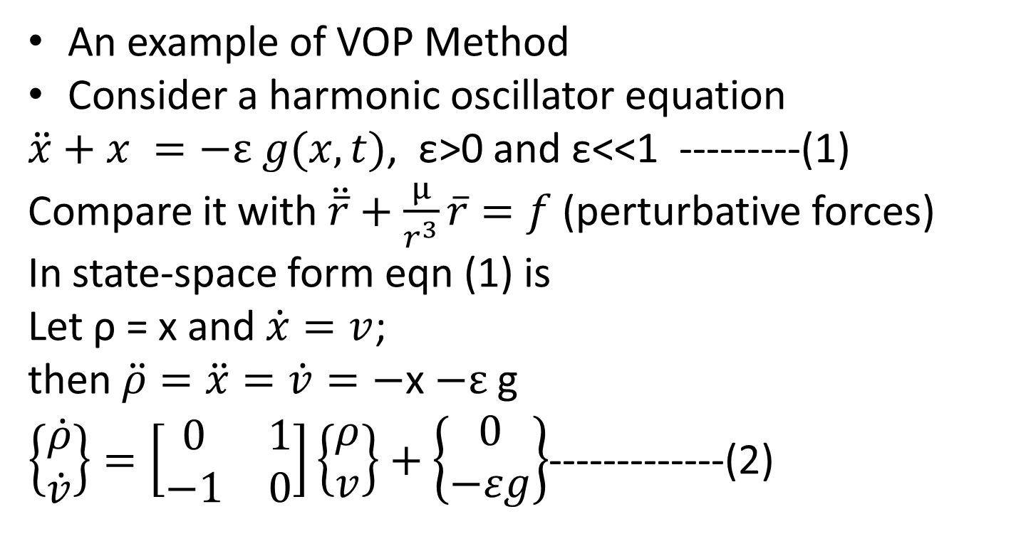
Variation of Parameters Method for Perturbation Effects Example 1
An example of VOP Method
Consider a harmonic oscillator equation
$\ddot{x}+x =−ε g(x,t)$, ε>0 and ε<<1 ---------(1)
Compare it with $\ddot{\overline{r}}+\frac{µ}{r^{3}}\overline{r}=f$ (perturbative forces)
In state-space form eqn (1) is
Let ρ = x and $\dot{x}=v$;
then $\ddot{ρ}=\ddot{x}=\dot{v}=−$x$−ε$ g
$\left\{\begin{matrix}\dot{ρ} \\ \dot{v}\end{matrix}\right\}=\left[\begin{matrix}0 & 1 \\ −1 & 0\end{matrix}\right]\left\{\begin{matrix}ρ \\ v\end{matrix}\right\}+\left\{\begin{matrix}0 \\ −εg\end{matrix}\right\}$-------------(2)

Slide 56
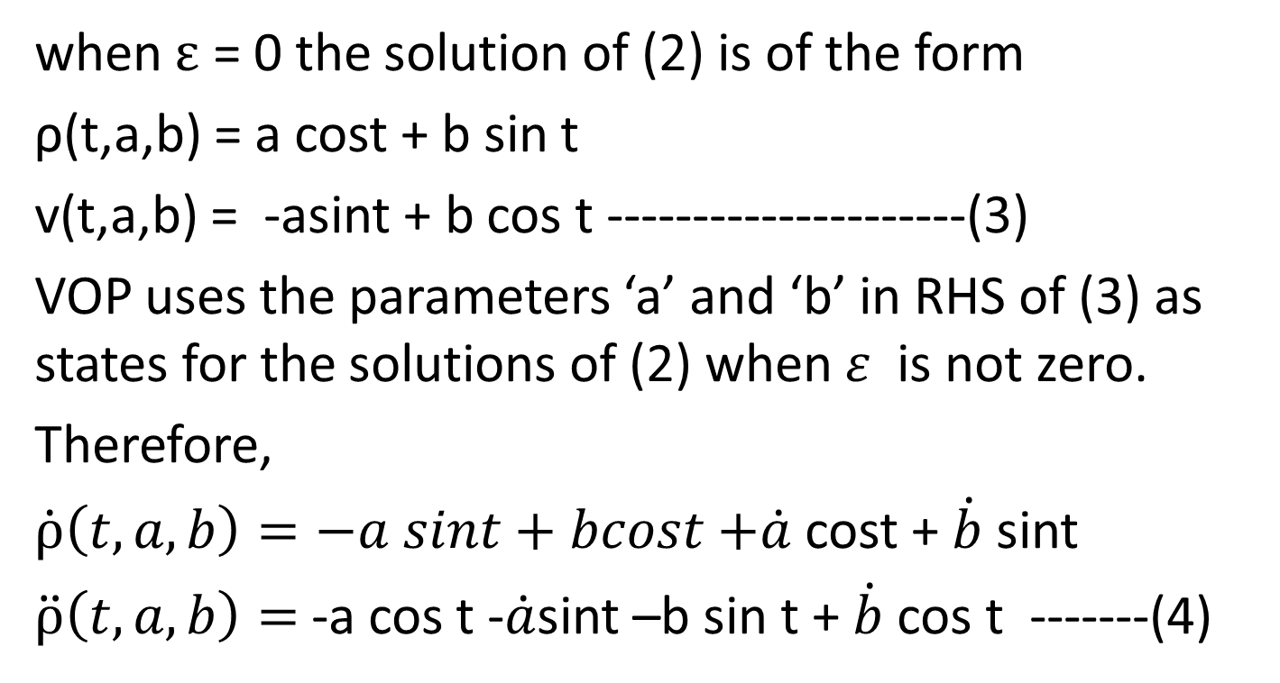
Variation of Parameters Method for Perturbation Effects
when $ε$ = 0 the solution of (2) is of the form
ρ(t,a,b) = a cost + b sin t
v(t,a,b) = -asint + b cos t ---------------------(3)
VOP uses the parameters ‘a’ and ‘b’ in RHS of (3) as states for the solutions of (2) when $ε$ is not zero.
Therefore,
$\dot{ρ}\left(t,a,b\right)=−a sint+bcost$$+\dot{a}$ cost + $\dot{b}$ sint
$\ddot{ρ}\left(t,a,b\right)=$-a cos t -$\dot{a}$sint –b sin t + $\dot{b}$cos t -------(4)

Slide 57
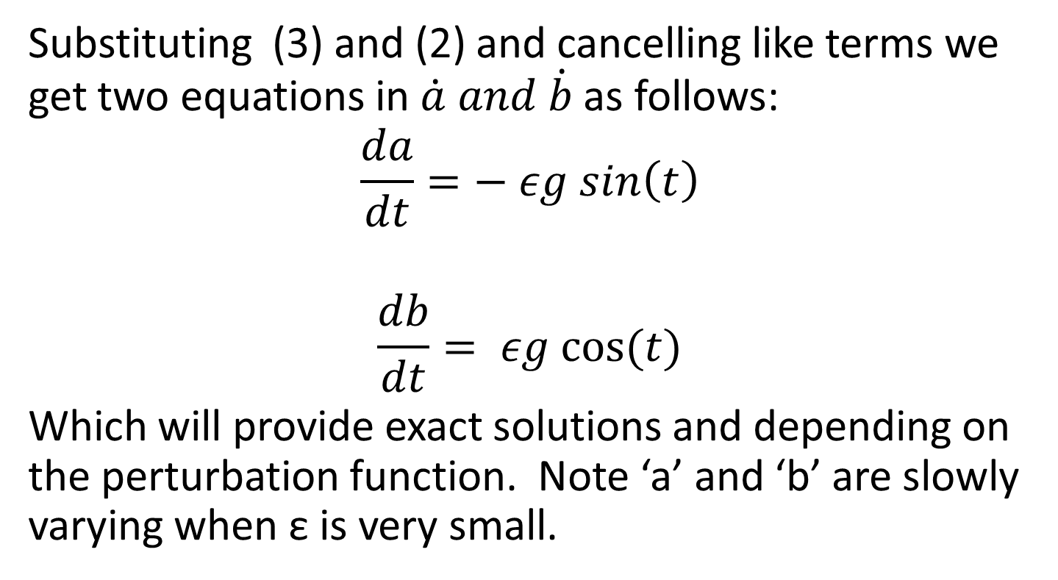
Variation of Parameters Method for Perturbation Effects
Substituting (3) and (2) and cancelling like terms we get two equations in $\dot{a} and \dot{b}$ as follows:
$$\frac{da}{dt}=− εg sin\left(t\right)$$
$$\frac{db}{dt}= εg cos⁡(t)$$
Which will provide exact solutions and depending on the perturbation function. Note ‘a’ and ‘b’ are slowly varying when ε is very small.

Slide 58
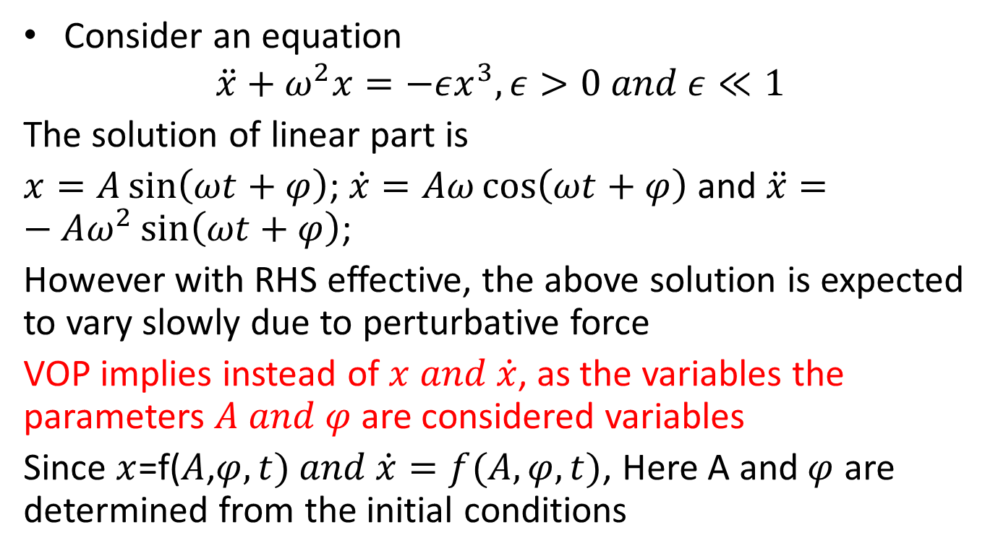
Example 2 VOP for a 2nd Order System
Consider an equation
$$\ddot{x}+ω^{2}x=−εx^{3}, ε>0 and ε≪1$$
The solution of linear part is
$x=A\sin\left(ωt+φ\right)$; $\dot{x}=Aω\cos\left(ωt+φ\right)$ and $\ddot{x}=−Aω^{2}\sin\left(ωt+φ\right)$;
However with RHS effective, the above solution is expected to vary slowly due to perturbative force
VOP implies instead of $x and \dot{x}$, as the variables the parameters $A and φ$are considered variables
Since $x$=f($A$,$φ,t) and \dot{x}=f(A,φ,t)$, Here A and$φ$ are determined from the initial conditions

Slide 59
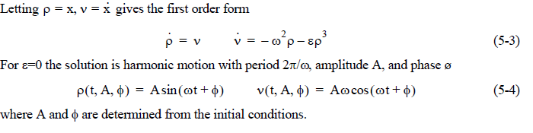
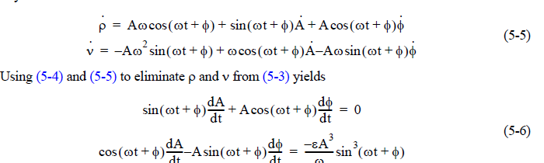
VOP for a 2nd Order System

Slide 60
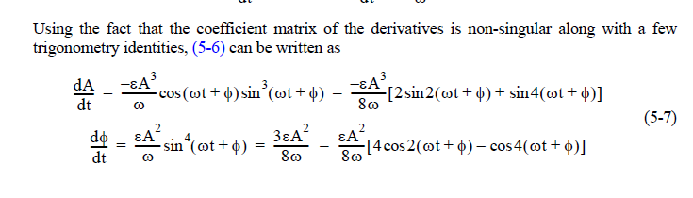
VOP for a 2nd Order System
Note that: Amplitude equation is periodic and phase equation has a secular term
Therefore, the equation with nonlinear terms is becoming unstable with phase is increasing continueosly but slowly

Slide 61
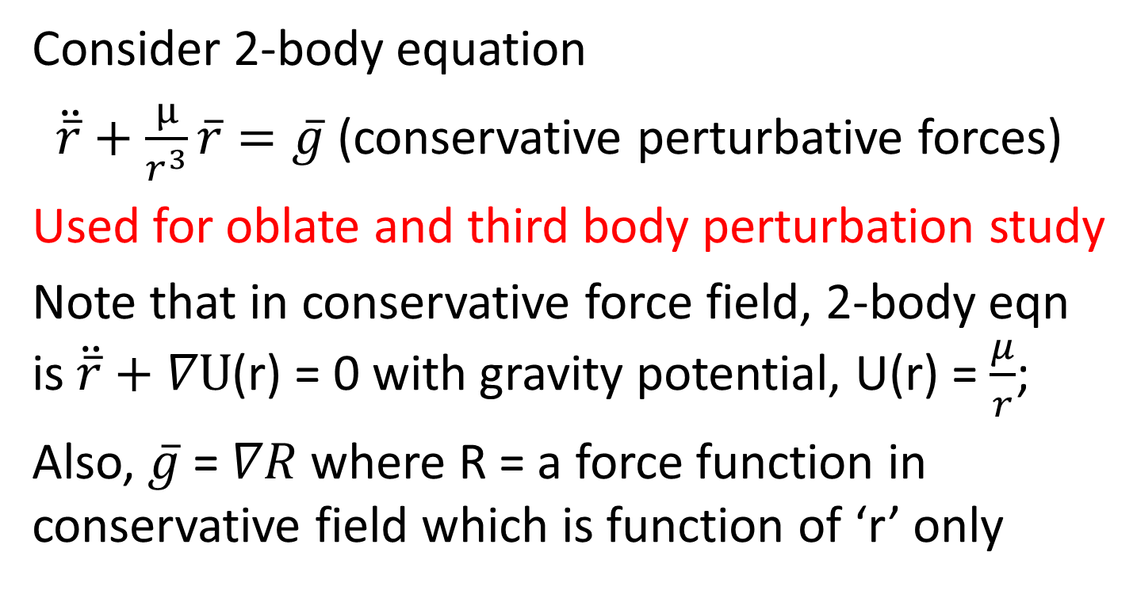
VOP Method for Perturbation Effects of 2-body problem
Consider 2-body equation
$\ddot{\overline{r}}+\frac{µ}{r^{3}}\overline{r}=\overline{g}$(conservative perturbativeforces)
Used for oblate and third body perturbation study
Note that in conservative force field, 2-body eqn is$\ddot{\overline{r}}+∇U$(r) = 0 with gravity potential, U(r) = $\frac{μ}{r}$;
Also, $\overline{g}$ = $∇R$ where R = a force function in conservative field which is function of ‘r’ only

Slide 62
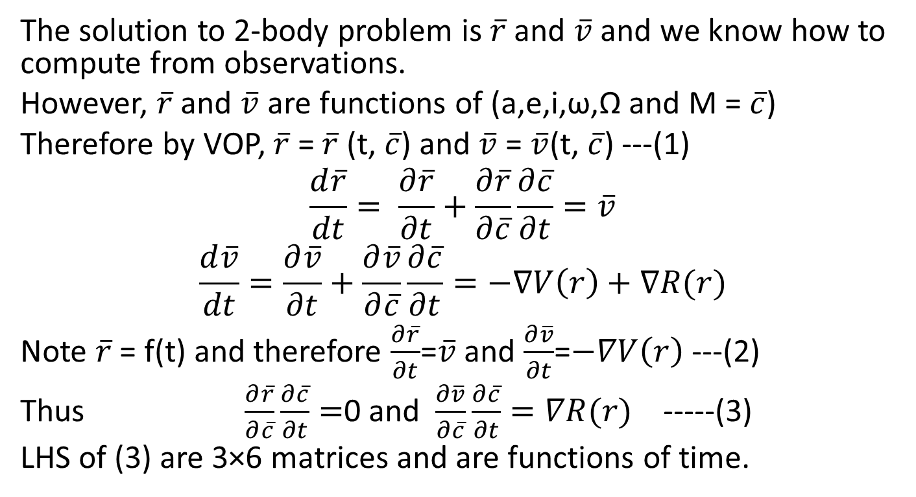
VOP Method for Perturbation Effects of 2-body problem
The solution to 2-body problem is $\overline{r}$ and $\overline{v}$ and we know how to compute from observations.
However, $\overline{r}$ and $\overline{v}$ are functions of (a,e,i,ω,Ω and M = $\overline{c}$)
Therefore by VOP, $\overline{r}$= $\overline{r}$(t, $\overline{c}$) and $\overline{v}$ = $\overline{v}$(t,$\overline{c}$) ---(1)
$$\frac{d\overline{r}}{dt}= \frac{∂\overline{r}}{∂t}+\frac{∂\overline{r}}{∂\overline{c}}\frac{∂\overline{c}}{∂t}=\overline{v}$$
$$\frac{d\overline{v}}{dt}=\frac{∂\overline{v}}{∂t}+\frac{∂\overline{v}}{∂\overline{c}}\frac{∂\overline{c}}{∂t}=−∇V\left(r\right)+∇R(r)$$
Note $\overline{r}$= f(t) and therefore $\frac{∂\overline{r}}{∂t}$=$\overline{v}$ and $\frac{∂\overline{v}}{∂t}$=$−∇V\left(r\right)$ ---(2)
Thus $\frac{∂\overline{r}}{∂\overline{c}}\frac{∂\overline{c}}{∂t}=$0 and $\frac{∂\overline{v}}{∂\overline{c}}\frac{∂\overline{c}}{∂t}=∇R(r)$ -----(3)
LHS of (3) are 3×6 matrices and are functions of time.

Slide 63
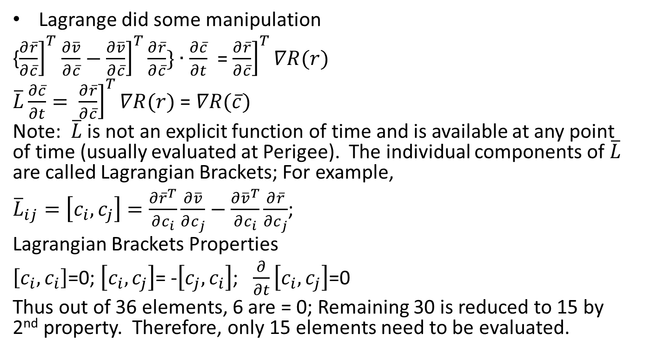
VOP – 2-body problem
Lagrange did some manipulation
{${\left.\frac{∂\overline{r}}{∂\overline{c}}\right]}^{T}$$\frac{∂\overline{v}}{∂\overline{c}}−$${\left.\frac{∂\overline{v}}{∂\overline{c}}\right]}^{T}\frac{∂\overline{r}}{∂\overline{c}}\}∙\frac{∂\overline{c}}{∂t}$ = ${\left.\frac{∂\overline{r}}{∂\overline{c}}\right]}^{T}∇R(r)$
$\overline{L}\frac{∂\overline{c}}{∂t}= {\left.\frac{∂\overline{r}}{∂\overline{c}}\right]}^{T}∇R(r)$ = $∇R(\overline{c})$
Note: $\overline{L}$ is not an explicit function of time and is available at any point of time (usually evaluated at Perigee). The individual components of $\overline{L}$ are called Lagrangian Brackets; For example,
${\overline{L}}_{ij}=\left[c_{i}, c_{j}\right]=\frac{∂{\overline{r}}^{T}}{∂c_{i}}\frac{∂\overline{v}}{∂c_{j}}−\frac{∂{\overline{v}}^{T}}{∂c_{i}}\frac{∂\overline{r}}{∂c_{j}}$;
Lagrangian Brackets Properties
$\left[c_{i}, c_{i}\right]$=0; $\left[c_{i}, c_{j}\right]$= -$\left[c_{j}, c_{i}\right]$; $\frac{∂}{∂t}\left[c_{i}, c_{j}\right]$=0
Thus out of 36 elements, 6 are = 0; Remaining 30 is reduced to 15 by 2nd property. Therefore, only 15 elements need to be evaluated.

Slide 64
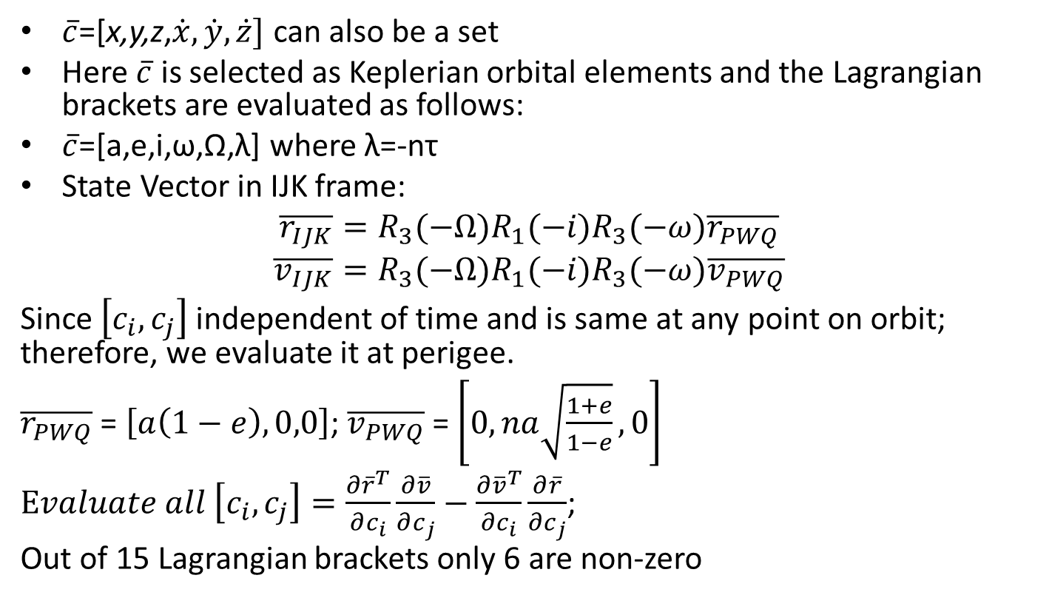
Lagrangian Brackets for Keplerian Orbital Elements
$\overline{c}$=[x,y,z,$\dot{x},\dot{y},\dot{z}]$ can also be a set
Here $\overline{c}$ is selected as Keplerian orbital elements and the Lagrangian brackets are evaluated as follows:
$\overline{c}$=[a,e,i,ω,Ω,λ] where λ=-nτ
State Vector in IJK frame:
$$\overline{r_{IJK}}=R_{3}(−Ω)R_{1}(−i)R_{3}(−ω)\overline{r_{PWQ}}$$
$$\overline{v_{IJK}}=R_{3}(−Ω)R_{1}(−i)R_{3}(−ω)\overline{v_{PWQ}}$$
Since $\left[c_{i}, c_{j}\right]$ independent of time and is same at any point on orbit; therefore, we evaluate it at perigee.
$\overline{r_{PWQ}}$ = $\left[a\left(1−e\right),0,0\right]$; $\overline{v_{PWQ}}$ = $\left[0, na\sqrt{\frac{1+e}{1−e}}, 0\right]$
$Evaluate all \left[c_{i}, c_{j}\right]=\frac{∂{\overline{r}}^{T}}{∂c_{i}}\frac{∂\overline{v}}{∂c_{j}}−\frac{∂{\overline{v}}^{T}}{∂c_{i}}\frac{∂\overline{r}}{∂c_{j}}$;
Out of 15 Lagrangian brackets only 6 are non-zero

Slide 65
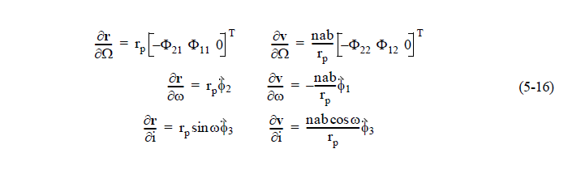
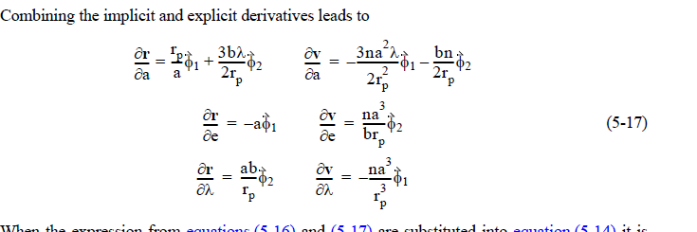
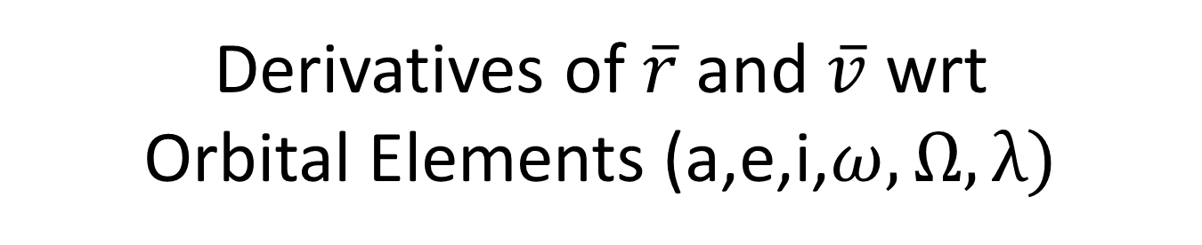
Derivatives of $\overline{r}$ and $\overline{v}$ wrt Orbital Elements (a,e,i,$ω,Ω,λ)$

Slide 66
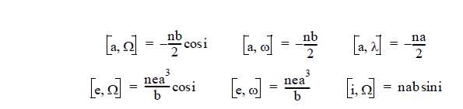
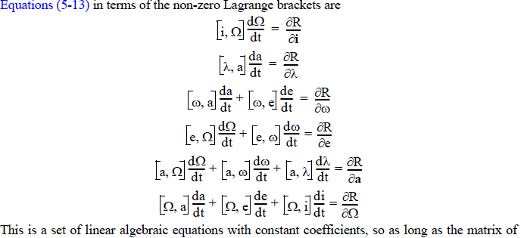
Lagrangian Brackets and Lagrangian Planetary Equations
The six non-zero Lagrangian brackets out of the fifteen are

Slide 67

Final Variational Equations in terms of R(r)
Now substituting and rearranging we get $\overline{L}\frac{d\overline{c}}{dt}$= $∇R(\overline{c})$ as
$\frac{da}{dt}=\frac{2}{na}\frac{∂R}{∂λ}$ ; $\frac{de}{dt}=\frac{−b}{na^{3}e}\frac{∂R}{∂ω}+\frac{b^{2}}{na^{4}e}\frac{∂R}{∂λ}$
$\frac{di}{dt}=−\frac{1}{nab\sin{i}}\frac{∂R}{∂Ω}+\frac{\cos{i}}{nab\sin{i}}\frac{∂R}{∂ω}$; $\frac{∂Ω}{∂t}=\frac{1}{nab\sin{i}}\frac{∂R}{∂i}$
$\frac{dω}{dt}=−\frac{\cos{i}}{nab\sin{i}}\frac{∂R}{∂i}+\frac{b}{na^{3}e}\frac{∂R}{∂e}$; $\frac{dλ}{dt}=−\frac{2}{na}\frac{∂R}{∂a}−\frac{b^{2}}{na^{4}e}\frac{∂R}{∂e}$

Slide 68
Gravitational Potential Theory, J₂ Model (cont’d)
• J1 --> Gravitational Potential of Spherical earth
• J2 --> Accounts for Equatorial Bulge
• So-named J2 Effect
J2 -- torques the orbit

Slide 69

Effect of J2 on Orbital Elements
R(r) is f(a,e,i) only and there is no secular variations in a,e,i. Therefore orbit shape is not affected.
Physical meaning is that the average energy is preserved and the ‘z’ component of the angular momentum is not changed.
If only we consider the secular variations of effects on Ω,ω, λ due to J2 we get
$\frac{dΩ}{dt}=−\frac{3}{2}nJ_{2}{\left(\frac{R}{p}\right)}^{2}\cos{i}$
$\frac{dω}{dt}=\frac{3}{4}nJ_{2}{\left(\frac{R}{p}\right)}^{2}(5\cos^{2}i−1)$
$\frac{dλ}{dt}=\frac{3}{4}nJ_{2}{\left(\frac{R}{p}\right)}^{2}\sqrt{\left(1−e^{2}\right)}(3\sin^{2}i−2)$

Slide 70
How Does J₂ Torque the Orbit? (cont’d)
• Spherical Earth …
Gravitational force acts
On a straight line between CG
Of satellite and the center of
the earth
• No moment arm to act on
.. Thus no torque

Slide 71
How Does J₂ Torque the Orbit? (cont’d)
• Oblate (J₂) Earth …
• Spacecraft is closer to
the centroid of one
hemisphere than the
centroid of the
other hemisphere
Distance from hemisphere centroid

Slide 72
How Does J₂ Torque the Orbit? (cont’d)
• Oblate (J₂) Earth …
• Gravitational force no longer
acts through center of the earth
Gravitational Force Vector
(components Radial and Perpendicular
direction)

Slide 73
J₂ Gravity Model (revisited)
Re-write in terms of {i_{ν}, i_{k}}

Slide 74
Rotation from {λ,δ} to{ν,k}
Ascending orbit

Slide 75
Rotation from {λ,δ} to{ν,k}
Descending orbit

Slide 76
Rotation from {λ,δ} to{ν,k}(cont’d)
Ascending orbit
Descending Orbit
• For J₂ Model
Why?

Slide 77
J₂ Gravity Model orbital plane effects
+ depending on “ascending, descending”

Slide 78
J₂ Gravity Model orbital plane effects (cont’d)
+ depending on “ascending, descending”

Slide 79
J₂ Gravity Model orbital plane effects (cont’d)
• Effect of F_{λ}
• Effect of F_{κ}

Slide 80
How Does J₂ Torque the Orbit? (cont’d)
• Oblate (J₂) Earth …
• Net torque on orbit
Due to vector results
in precession of the
line-of-nodes

Slide 81
Precession of the Right Ascension (J2 Nodal Regression)
General Formula
When Averaged Over an entire orbit

Slide 82
Precession of the Right Ascension (J2 Nodal Regression)
Earth Formula
When Averaged Over an entire orbit
°/civil
day

Slide 83
Precession of the Right Ascension (Nodal Regression)
When Averaged Over
an entire orbit
deg/
civil
day

Slide 84

Precession of the Right Ascension (J2 Nodal Regression)
When Averaged Over an entire orbit
Nodal Precession
Earth orbit

Slide 85
J₂ Effect: Perigee Rotation
Orbit rotates in orbital plane
Notes:
Another affect the oblateness of the Earth causes is the rotation of the perigee around the earth.
The oblateness of the Earth causes the force of gravity on a satellite to vary as the satellite orbits the Earth. The result is that the perigee of the orbit will rotate in the orbital plane.
An exception to this is the Molniya type orbit which uses the combination of high eccentricity, a semi-synchronous period and a specific orbital inclination to keep the perigee in the same location.
If a satellite’s orbit is perfectly circular then all points in the orbit are the apogee and the perigee. There are enough forces acting on a satellite that will keep it from ever having a perfectly circular orbit other than for an instant

Slide 86
J₂ Effect Perigee Rotation
• Asymmetrically
distributed torque
forces perigee rotation
within Orbital plane
Notes:
Another affect the oblateness of the Earth causes is the rotation of the perigee around the earth.
The oblateness of the Earth causes the force of gravity on a satellite to vary as the satellite orbits the Earth. The result is that the perigee of the orbit will rotate in the orbital plane.
An exception to this is the Molniya type orbit which uses the combination of high eccentricity, a semi-synchronous period and a specific orbital inclination to keep the perigee in the same location.
If a satellite’s orbit is perfectly circular then all points in the orbit are the apogee and the perigee. There are enough forces acting on a satellite that will keep it from ever having a perfectly circular orbit other than for an instant

Slide 87
Variation of Argument of Perigee _{(cont’d)}
• Earth Formula
°/
civil
day
When Averaged Over an entire orbit

Slide 88
Variation of Argument of Perigee _{(cont’d)}
When Averaged Over an entire orbit
• General Formula

Slide 89
J₂ Effect: Perigee Rotation
Orbit rotates in orbital plane
Notes:
Another affect the oblateness of the Earth causes is the rotation of the perigee around the earth.
The oblateness of the Earth causes the force of gravity on a satellite to vary as the satellite orbits the Earth. The result is that the perigee of the orbit will rotate in the orbital plane.
An exception to this is the Molniya type orbit which uses the combination of high eccentricity, a semi-synchronous period and a specific orbital inclination to keep the perigee in the same location.
If a satellite’s orbit is perfectly circular then all points in the orbit are the apogee and the perigee. There are enough forces acting on a satellite that will keep it from ever having a perfectly circular orbit other than for an instant

Slide 90

Variation of Argument of Perigee
When Averaged Over an entire orbit

Slide 91
When Averaged Over an entire orbit
Variation of Argument of Perigee
“civil”
• An Interesting result:
Or 116°.6
Perigee does not rotate

Slide 92
Some Special Orbits
With use of J2 Effect
Sun-Synchronous Orbits Critical Inclination Orbits

Slide 93

Sun Synchronous Polar Orbit (SSPO)
- Orbit precession rate
The sun synchronous orbit can be defined as the orbit in which the orbital plane rotates in a year in unison with the one revolution / year apparent motion of the sun.
The advantage of the sun synchronous orbit is that the observation conditions can be kept with a constant solar incident angle.

Slide 94
Design Steps for a Repeating Sun-Synchronous Orbit
The local time of the Sun synchronous orbit is usually decided based on the lighting requirements at the equatorial crossing nodes.
When the Sun is over the orbit meridian it is Noon; it is for ascending node leg or otherwise it is for descending node leg.
N
Example: Descending node LT= 10:30 hrs

Slide 95


Sun-Synchronous Height vs Inclination Plot
$\frac{dΩ}{dt}=−\frac{3}{2}nJ_{2}{\left(\frac{R}{p}\right)}^{2}\cos{i}$
= 0.985647 deg/day
Lower heights – drag perturbation problem >500 Km selected
Heights above 1000 Km – problem due to South Atlantic Anomaly

Slide 96

SAA Spread for 600 Km orbit

Slide 97
Hazards of Human Flight – Van Allen Belts
Millions of ev
15000Km
Van
Allen
Belts
30000ev
3000Km

Slide 98

Sun-synchronous orbit design
$\frac{dΩ}{dt}=−\frac{3}{2}nJ_{2}{\left(\frac{R}{p}\right)}^{2}\cos{i}$
$\frac{dω}{dt}=\frac{3}{4}nJ_{2}{\left(\frac{R}{p}\right)}^{2}(5\cos^{2}i−1)$
$∆n=n−n_{0}=−\frac{3}{4}n_{0}J_{2}\frac{R^{2}}{p^{2}}\left(1−3 \cos^{2}i\right)$
Therefore $n_{upd}$=$n_{0}+∆n+\dot{ω}$

Slide 99

Sun-synchronous orbit design
Node to node period $T_{N}$= $\frac{2π}{n+\dot{ω}}$ = draconic period
Now the earth would move in equatorial longitude in one $T_{N}$ by $∆L$degrees
(360+$\frac{360}{365.242199})=86400s$ = solar day = 360(1+$\frac{1}{s})$;
Sidereal day = 86164 = 86400/(1+$\frac{1}{s})$
$ω_{e}=$ 360/sidereal day = 360(1+$\frac{1}{s})$$⁰/{day}$
$\dot{Ω}$ = $\frac{360}{s}$$⁰/{day}$
$∆L$ = ($ω_{e}−\dot{Ω}$)*$T_{N}$=$\frac{360}{86400}$*$T_{N}$;
Usually the repetition of same meridian after ‘N’ orbits in ‘K’ days is expected; therefore
$T_{N}= \frac{K}{N}$ days/orbit
$T_{N}$ = $\frac{K}{N}$* 86400 secs/orbit $n_{0}$= $\frac{1}{T_{N}}$*360 = degrees/day

Slide 100


Height vs$Equatorial ∆L$ (for one day repeat orbits)

Slide 101

Sun-Synchronous Ground Trace

Slide 102

Design of European Remote Sensing Satellite (ERS-1) - Example
Design ERS-1 sun-synchronous orbit for K=3 day cycle with N=43 orbits repetition for ascending node local time.$J_{2}=0.00108144$
To start with draconic period = $T_{N}$=$\frac{K}{N}$=0.0697674 days/orbit=6027.907 secs (assumed $∆n=0 and \dot{ω}=0)$
$n_{0}=360/T_{N}$= 5160⁰
But $T_{N}=2π\sqrt{\frac{a^{3}}{μ}}$ ; Solving for a=7159.06 Km; h = 780.923 Km
We want $\frac{dΩ}{dt}=−\frac{3}{2}nJ_{2}{\left(\frac{R}{p}\right)}^{2}\cos{i}$=0.98564724⁰/day; assuming e=0, R= 6378.137 Km, i = 98.5316⁰
Therefore, a= 7159.06 Km, e = 0.0 and i= 98.5316⁰ (1st iteration)

Slide 103

Design of European Remote Sensing Satellite (ERS-1) – Example - continued
Design ERS-1 sun-synchronous orbit for K=3 day cycle with N=43 orbits repetition for ascending node local time.$J_{2}=0.00108144$
$J_{2}$ also affects ‘n’ and $′ω$’ ;
$\frac{dω}{dt}=\frac{3}{4}nJ_{2}{\left(\frac{R}{p}\right)}^{2}(5\cos^{2}i−1)$; $\dot{ω}$=-2.9565 $°/{day}$
n$−n_{0}=−\frac{3}{4}nJ_{2}{\left(\frac{R}{p}\right)}^{2}\sqrt{\left(1−e^{2}\right)}\left(3\sin^{2}i−2\right)=−3.10266$$°/{day}$
$n_{new}=n_{0}+∆n$ + $\dot{ω}$ = 5166.05⁰; $∴T_{N}=6020.85 secs$
$a_{new}$= 7153.155 Km ; altitude h = 775.018 Km; i= 98.5074⁰
The iterations further provide very good convergence and so the ground track repeatability can be achieved.

Slide 104

Example Ground Tracks
LEO sun-synchronous ground track

Slide 105

TYPICAL IRS PAYLOAD PASS

Slide 106

Molniya Orbits
Molniya Orbits exploit this quirk of nature
63.4 /116.6 Degree Inclination
500 km perigee - 40,000 km apogee
Semi-major axis = 26555; ecc = 0.7222
i= 63.3 deg and $ω=270 deg$
Missions: Comm / Surveillance
Notes:
Any orbit with an eccentricity greater than 0.5 is considered to be a highly elliptical orbit.
The most common highly elliptical orbit is the Molniya orbit, originally conceived and used by the Soviet Union. The Soviets calculated that by launching a satellite into a highly eccentric orbit with an inclination of 63.4 degree the perturbation caused by the oblateness of the earth (rotation of the perigee point) was negated. The orbit would stay stable with the apogee constantly occurring over the northern hemisphere.
This was a benefit for two reasons:
First, the satellite’s orbit provides better coverage of the Russian land mass for communications than a geosynchronous satellite. Communications satellites in a geostationary orbit can only provide reliable communications from about 70 degrees north latitude to 70 degrees south latitude. Much of Siberia and northern Russia is above 70 degrees north latitude.
Second, the ability to launch directly into this orbit (saving on launch costs) was available simply by constructing a launch site at Plesetsk (63.4 degrees).
As you recall, a satellite moves slower at its apogee than and fastest at its perigee. A satellite in a Molniya orbit is north of the Equator almost all the time an seems to linger near its apogee.
A disadvantage is that steerable antennas are needed at Earth terminals in order to maintain high data rate connections.

Slide 107
High Elliptic and Critical Inclination (63.4 degree) Orbits
To cover high latitude regions of country’s like Russia for communication purposes
Orbit has perigee at lower latitudes and apogee near higher latitudes
Line of Apsides will not rotate at 63.4 degrees
Coverage duration per orbit will be around 8 hrs
3 such satellites cover fully this region continuously for communications

Slide 108

Molniya Ground Trace

Slide 109

Geosynchronous and Molniya Orbit Ground Tracks
GEO ground track is a point (or may trace out a very small, closed path)
Molniya ground track “hovers” over Northern latitudes for most of the time, at one of two longitudes

Slide 110



Effect of ODD Zonal harmonics ‘Frozen Perigee’ Orbits
Potential disturbing function due to $J_{3}$=
Effect of $J_{3}−$ affects ‘e’ and ‘i’
When we proceed and workout in a similar way as in $J_{2}$we get effect only in ‘e’
$$\frac{de}{dt}=\frac{3}{8}nJ_{3}\frac{R^{3}}{ap^{2}}\left[5\sin^{3}i−4\sin{i}\right]\cos{ω}$$
Note change in ‘e’ is f(a,i,$ω)$; also, we know $J_{2}$effects ω; but change in ω effects ‘e’, though a, i are constants
What is ‘Frozen Orbit’? A frozen orbit is designed so that one or more of the orbital elements are ‘frozen’ or held constant in time.

Slide 111

How to design a ‘frozen orbit’?
Now let us combine the effects of both $J_{2} and J_{3}$:
$\frac{dω}{dt}=\frac{3nJ_{2}R^{2}(4−5\sin^{2}i)}{4a^{2}{\left(1−e^{2}\right)}^{2}}×\left\{1+\frac{J_{3}}{2J_{2}(1−e^{2})}\frac{R}{a}\frac{\sin{i}\sin{ω}}{e}\right\}$
Select ω=∓90 to get rid of variation in ‘e’
And select ‘e’≈$\frac{J_{3}}{2J_{2}}\frac{R}{a}\frac{\sin{i}\sin{90}}{1}$

Slide 112


Perturbations Due to 3rd Body
Orbital perturbations (example: third body)
Why they should not be neglected?
Satellites 1&2 (around Earth):
a=150900 km
e=0.8
i=0 deg
Satellite 1: only Earth’s gravity
Satellite 2: Earth + Moon + Sun

Slide 113

Third body in Solar System

Slide 114









Form of Disturbing Potential due to Third Body
$$\overline{d}$$
$$m_{3}$$
$$\overline{r}$$
$$m_{2}$$
$${\overline{e}}_{r}$$
$${\overline{e}}_{s}$$
S
$${\overline{r}}^{′}$$
$$m_{1}$$
$R=\frac{μ′}{\sqrt{{r′}^{2}+r^{2}−2r^{′}r\cos{S}}}=\frac{μ′}{r′}\sum_{n=2}^{∞}{{\left(\frac{r}{r′}\right)}^{n}P_{n}\left(\cos{S}\right)}$
$μ′=G(m_{2})$ and R = $\frac{μ′}{d}$; Further, r’ >> r (Legendre Expansion is valid)

Slide 115

Effect of 3rd Body Perturbations
Acceleration on $m_{3}$ due to 2-body ($m_{2}$) is = $\frac{μ′}{d^{3}}\overline{d}$ which is valid in Newtonian co-ordinate system of Primary body which itself is accelerating.
However, notice that the primary of the binary system is given an extra acceleration by $m_{2}$ = $\frac{μ′}{{r′}^{3}}\overline{r′}$
The net acceleration on $m_{3}$then $\ddot{\overline{r}}$= $\frac{μ′}{d^{3}}\overline{d}−$(-$\frac{μ′}{{r′}^{3}}\overline{r′}$)
After approximations $\ddot{\overline{r}}$=$\frac{μ^{′}r}{d^{3}}\left[−{\overline{e}}_{r}+3{\overline{e}}_{s}\cos{S}\right]$
When S= 90°, $\ddot{\overline{r}}$= $\frac{μ^{′}r}{d^{3}}\left[−{\overline{e}}_{r}\right]$ and when S=0°, $\ddot{\overline{r}}$=$\frac{μ^{′}r}{d^{3}}\left[2{\overline{e}}_{r}\right]$

Slide 116
3rd Body Effect - Physics
Satellite is attracted by Sun; therefore the orbit plane is attracted towards the ecliptic plane introducing a gyroscopic precession. The line of nodes precesses along the ecliptic plane.
Satellite is attracted by Moon as well; Moon’s orbit has another 5 deg wrt ecliptic plane; yet another precession wrt to normal of Moon’s orbit is introduced with a period of 18.6 years
This amounts to variation in Ω and ω rates and indirectly affecting ‘i’

Slide 117

Perturbation due to Third Body - precession of Earth

Slide 120
Perturbation due to Third Body
Effects orbital parameters ‘Ω and ω’ only

Slide 121

Motion of the Earth Spin Axis Over Several Years

Slide 122

Summary of 3rd Body effects
No secular, long periodic variation in ‘a’
Secular variations in nodal and apsidal line only, that is Ω and ω only
Long periodic variations on ‘i’, ‘e’, Ω and ω are due to motions of satellite orbit’s perigee and disturbing body
In Near earth orbit (NEO, LEO) $J_{2}$ dominates and orbital plane regresses about polar axis
For HEO, the regression will be about some mean pole lying between the Earth’s Pole and Ecliptic Pole.

Slide 123
Perturbation - Air Drag
DECREASES THE SEMI-MAJOR AXIS - ‘a’
For Remote Sensing Mission : Ground Track Control
For Very Low Earth Orbit : Spirals & Re-enters Earth
For Geosynchronous Orbit : No Effect
Drag Force = Atmospheric Density (Varies Exponentially With Height), Ballistic Coefficient, Relative Velocity

Slide 124

Earth’s Atmosphere – a look

Slide 125


Slide 126
Atmospheric Drag
Notes:
Another key perturbation is atmospheric drag on low Earth orbiting satellites.
Due to solar activity the atmosphere of the earth expands and contracts.
The the atmosphere expands outward into space, atmospheric drag increases causing the satellite to slow down. Since it is moving more slowly it has less energy. The result is that the apogee is significantly lower and lower while the altitude of the perigee only drops a little. Slowing a satellite in an elliptical orbit at the perigee orbit tends to make the orbit more circular.
The effect can be overcome if the satellite has thruster to increase its speed and raise the altitude of the orbit.
Many satellites conduct periodic thruster burns to compensate for the effects of atmospheric drag. The Mir Russian space station is large with a significant cross section. Atmospheric drag has a significant effect on its orbit so thruster burns are carried out routinely.

Slide 127
Perturbation - Air Drag

Slide 128

D
R
A
G
F
O
R
C
E

Slide 129

Reentry of Satellites by Air Drag
Effects orbital parameters ‘a’ and ‘e’

Slide 130

Aerodynamic Drag Effect (Gauss Approach)
Vis-viva Law = $v^{2}=μ\left(\frac{2}{r}−\frac{1}{a}\right)$
Differenciating once $2vδv=\frac{μ}{a^{2}}δa$ (r = constant) $≅ δa=2\frac{a^{2}}{μ}vδv$
Note: if $δa$ to be changed energy increment /decrement via ‘v’ to be added/removed – perigee has higher velocity and therefore increments / decrements to be at perigee.
Instead of impulsive, we give finite burn we get
$\frac{da}{dt}=2\frac{a^{2}}{μ}v\frac{dv}{dt}=$$2\frac{a^{2}}{μ}va_{t}$ - along tangential direction

Slide 131

Aerodynamic Drag Effect (Gauss Approach)
$\frac{da}{dt}=2\frac{a^{2}}{μ}v\frac{dv}{dt}=$$2\frac{a^{2}}{μ}va_{t}$
$\frac{de}{dt}=\left[\frac{2(e+\cos{θ)a_{t}−r/a\left[\sin{θ}\right]a_{r}}}{v}\right]$
$\frac{di}{dt}=\frac{r\cos\left(ω+θ\right)a_{h}}{h}$
$\frac{dΩ}{dt}=\frac{r\sin\left(ω+θ\right)a_{h}}{h\sin{i}}$
And argument of perigee and mean motion has much more complicated expressions
Observations: out of plane or inclination correction is perpendicular to orbit plane – max or min when $ω+θ=$ is +1 or -1 (0 or 180 deg) which happens to be ascending / descending node; when the orbit is highly eccentric ‘i’ change should be at apogee / nodal line combination

Slide 132
Orbital Energy Analysis

Slide 133
Orbital Energy Analysis (cont’d)
Δ

Slide 134
Orbital Energy Analysis (cont’d)

Slide 135
Orbital Energy Analysis (cont’d)

Slide 136
Orbital Energy Analysis (cont’d)

Slide 137
Orbital Energy Analysis (cont’d)

Slide 138
Aerodynamic Forces

Slide 139
Drag Force
γ

Slide 140
Drag Force (cont’d)

Slide 141
Drag Force (cont’d)
Air “sticks” to
Earth boundary

Slide 142
Drag Force (cont’d)

Slide 143

Bound the Velocity error
$$+$$

Slide 147
Orbit Decay Equation

Slide 148
Orbit Decay Equation (cont’d)

Slide 149
Ballistic Coefficient (Orbit decay parameter)
• NORAD codes like SGP4 use a B* coefficient instead of
Drag Coefficient
• More Direct Measure of orbit Decay
kg/m³

Slide 150
Ballistic Coefficient (cont’d)
• Just to make it more confusing …..
NORAD Two-line-element (TLE) sets display B*
In units of earth radii ⁻¹
kg/m³
• Drag force

Slide 151
Ballistic Coefficient (cont’d)
• Drag force

Slide 152
Orbit decay equation

Slide 153
Orbit decay equation (cont’d)
1
1

Slide 155
Numerical Example
Orbit Decay of Russian Zarya Module
WHAT IF ENGINE QUIT WORKING ?

Slide 156
Russian
Zarya
Module

Slide 157
Russian Zarya Module

Slide 158
Russian Zarya Moduke
Russian Zarya Module

Slide 159
A Little Altitude at LEO makes a big Difference

Slide 160
A Little Altitude at LEO makes a big Difference (cont’d)

Slide 161
A Little Altitude at LEO makes a big Difference (cont’d)
h

Slide 162
Summary of Drag Effects
Secular changes occur in ‘a’, ‘e’ and ‘i’
Periodic changes occur in ‘i’, Ω and ω
Perigee height remains relatively constant but can be influenced by coupling effect due to central / third body effects
Correct atmospheric density is often the most difficult part in the model of drag.
Determining correct ballistic coefficient / correct varying surface area is other tough parameters to be estimated

Slide 163
Perturbations - Solar Radiation Pressure
Solar wind causes radiation pressure on the satellite
Effects similar to atmospheric drag
Effects are more pronounced on satellites with large surface areas
Effects on orbital parameters ‘e,i,Ω,ω’ only

Slide 164
Solar Radiation Pressure (concept)
Note:
Like drag force, SRP is also non-conservative
Drag is acting only opposing the motion of the spacecraft; however, SRP is coupled to attitude of the spacecraft and in all directions
The forces need to be evaluated along radial, tangential and normal directions
Attitude matrix transformation also need to be included
When in shadow SRP effect will not be there
Net Reaction Force
Reflected Momentum
Perfect flat reflector
Incident Momentum
Change in Momentum

Slide 165






Simple to Complex SRP Model
Cannon-ball like spherical model
“Box-Wing Model
$$P\left(R\right)=solar radiation$$
$$pressure at a given distance$$
$from the SUN$, $G_{1}=1×{10}^{14} Kg Km /s^{2}$ = solar radiation constant

Slide 166

Solar Radiation Pressure and the Distance
Radiation pressure for reflection
Solar Distance | µPa (µN/m²)
0.20 AU = close | 227
0.39 AU = Mercury | 60.6
0.72 AU = Venus | 17.4
1.00 AU = Earth | 9.08
1.52 AU = Mars | 3.91
3.00 AU = asteroid | 1.01
5.20 AU = Jupiter | 0.34
Energy Flux from Sun at 1 AU = 1340 Watts/$m^{2}$
The momentum flux = P = energy flux/ c = 4.5 $×{10}^{−6}\frac{N}{m^{2}}$
Interaction of photon with surfaces - some portions absorbed (translucent) - P, some portions reflected (1+ k) P and some simply pass through (1+-1) P (transparent media);
Completely absorbed – black body
Therefore, $P_{s}= α P$where $0<α<2, α=0 , transparent surfaces and α=2 for complete reflectors$ (mirrors); $P_{R}$ = 2 P

Slide 167


Material Properties $ε=reflectivity$ 1-ε = absorbivity, $C_{R}$= Correction Factor

Slide 168





Orbit Elements Variation Equations
Consider energy, momentum and eccentricity equations
and their derivatives in time:
Substituting for the terms in terms of orbital elements, the rates become

Slide 169



Orbit Elements Variation Equations
When Solar Radiation Pressure as a Fourier Expansion is incorporated, the rate expressions show
The important orbital elemental rates are

Slide 170

Why averaging over long period?

Slide 171

Final Keplerian Orbital Elements Variations Averaged over One Year

Slide 172
SRP – Variation of Orbits (Pictorial Simulation)
SRP Variation – show the video
Summary of Effects:
Induces periodic variations in all orbital elements
At heights > 800 Km it should be considered
Can affect satellites life time by effecting perigee height
Period of variation can be long to be a year due to annual motion of earth around Sun
Shadow effects changes the periodicity and may make it secular
For interplanetary missions, most important perturbation to be accounted for.

Slide 173
END OF PERTURBATIONS

